Slide 1
Decision Trees, Bagging, and Random Forests (modified from slides of Oznur Tastan)

Slide 2
Example of a decision tree (should we play outside?)
Each node is a test on
one attribute
Outlook
sunny
overcast
rain
Possible attribute values
of the node
Humidity
Yes
Windy
high
normal
true
false
Each leaf is associated with the majority class of training data along the path from the root
No
Yes
No
Yes

Slide 3
Three “positive class” examples
(Outlook ==overcast) -> yes
(Outlook==rain) and (not Windy) ->yes
(Outlook==sunny) and (Humidity=normal) ->yes
Outlook
sunny
overcast
rain
Humidity
Yes
Windy
high
normal
true
false
No
Yes
No
Yes

Slide 4
Different decision trees may be equivalent w.r.t. the data set
0
A
1
C
B
0
1
0
1
false
true
false
true
0
C
1
B
A
0
1
1
0
false
A
false
true
1
0
true
false

Slide 5
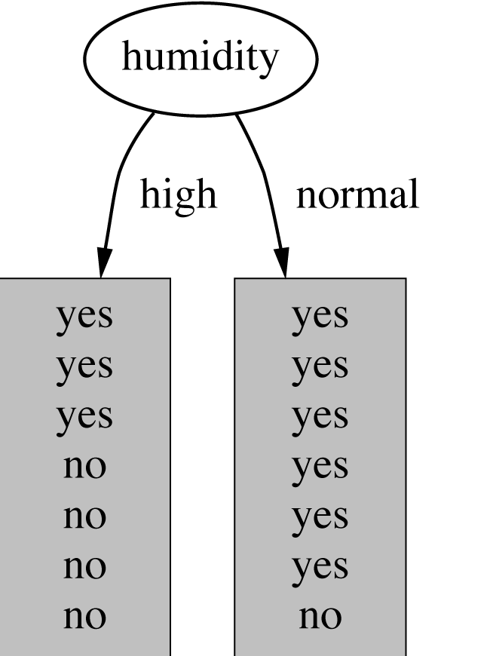
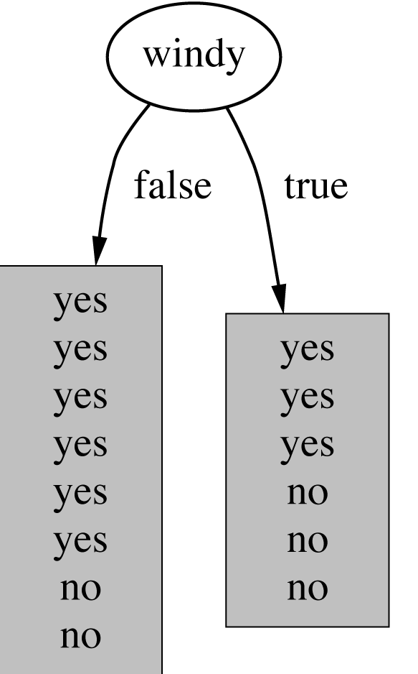
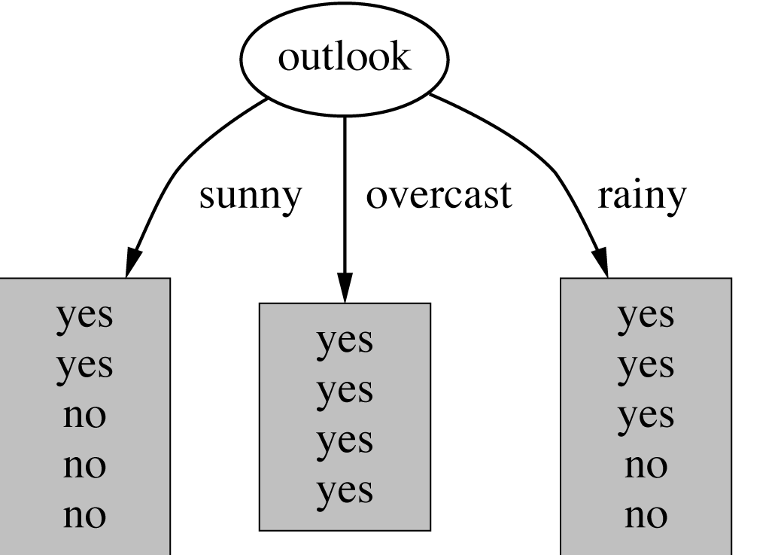
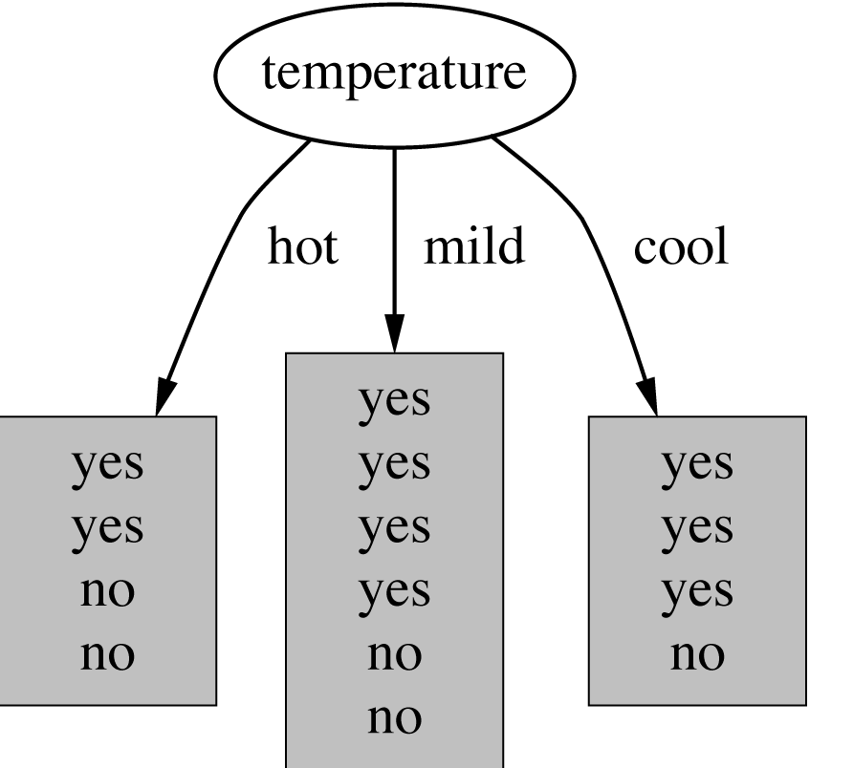
How do we choose the test ?
Which attribute should be used as the test?
Intuitively, you would prefer the
one that separates the training
examples as much as possible.

Slide 6
Entropy
The expected amount of information when observing the output of a random variable X
If X can have 8 outcomes and all are equally likely
bits

Slide 7
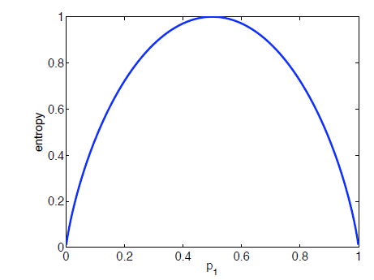
Entropy
If there are k possible outcomes
When does equality hold?
Coin-toss example, plotting
Entropy against prob(Heads)

Slide 8
Extreme cases (when a coin is tossed 8 times)
Max. entropy vs Max. purity
4 +
4 -
8 +
0 -

Slide 9
“Conditional” Reasoning (with uncertainty)
We begin with “priors”—what we believe before evidence arrives.
Once some evidence arrives, the priors are modified to “posteriors”.
“Conditionals” express what governs the transition from priors to posteriors.
Example:
Prior belief: probability that when you toss a coin, both heads and tails are equally likely.
Hypothesis H in the absence of evidence: coin is unbiased.
Evidence E: Someone tosses a coin 100 times, and gets 70H, 30T.
Posterior belief: the coin is biased, and heads are more than twice as likely as tails.
Conditional relationship exists between H and E.
Caution: “H” may stand for Heads, Hypothesis, or Entropy!

Slide 10
Expressing conditional relationships
P(X|Y) = P(X & Y)/P(Y), the probability of X, given Y.
= 3/5/4/5 = 3/4
Odds O(X|Y) = P(X|Y)/ P(not X|Y)
= 3/4/1/4
= 1
Positive Likelihood Ratio = O(X|Y)/O(X)
Mutual Information I(X;Y) = information obtained about one variable from another = D_{KL}(joint distribution, outer product distribution)
Conditional Entropy H(X|Y) = amount of information needed to specify X after Y has been observed = Entropy (X and Y) – Entropy(Y)
Notes:
“Outer product” = element-wise multiplication of vector components, which are not added together; the result is a vector of the same size.
“Inner product” = generalization of the dot product of vectors, resulting in a scalar
D_{KL}(P,Q) is the Kullback-Leibler divergence between distributions P and Q = - 𝛴_{x} (P(x) log (Q(x)/P(x)))

Slide 11
Conditional entropy

Slide 12
Information gain
IG(X,Y)=H(X)-H(X|Y)
Reduction in uncertainty associated with X, by knowing Y
Information gain:
(information before split) – (information after split)

Slide 13
Example
Attributes
Labels
X1 | X2 | Y | Count
T | T | + | 2
T | F | + | 2
F | T | - | 5
F | F | + | 1
Which one do we choose X1 or X2?
IG(X1,Y) = H(Y) – H(Y|X1)
H(Y) = - (5/10) log(5/10) -5/10log(5/10) = 1
H(Y|X1) = P(X1=T)H(Y|X1=T) + P(X1=F) H(Y|X1=F)
= 4/10 (1log 1 + 0 log 0) +6/10 (5/6log 5/6 +1/6log1/6)
= 0.39
Information gain (X1,Y)= 1-0.39=0.61

Slide 14
Which one do we choose?
X1 | X2 | Y | Count
T | T | + | 2
T | F | + | 2
F | T | - | 5
F | F | + | 1
Information gain (X1,Y)= 0.61
Information gain (X2,Y)= 0.12
Pick the variable which provides
the most information gain about Y
Pick X1

Slide 15
Recurse on branches
X1 | X2 | Y | Count
T | T | + | 2
T | F | + | 2
F | T | - | 5
F | F | + | 1
One branch
The other branch

Slide 16
Caveats
The number of possible values influences the information gain.
The more possible values, the higher the gain (the more likely it is to form small, but pure partitions)

Slide 17
Overfitting
You can perfectly fit to any training data
Zero bias, high variance
Two approaches:
1. Stop growing the tree when further splitting the data does not yield an improvement
2. Grow a full tree, then prune the tree, by eliminating nodes.

Slide 18
Ensemble Approaches in Machine Learning
Learning using a single model can result in errors, no matter how good the model and how expensive the learning process.
Ensemble approach: separately train multiple models that are different from each other, and combine their results in some manner.

Slide 19
Why Ensemble Approaches?
Everybody makes mistakes, but some make fewer mistakes than others!
In medical diagnosis, is it better to consult one very expensive physician specialist, or three much less expensive ones?
When judging figure skating (or singing or dancing) competitions, is it better to have one judge or many?

Slide 20
Combining decisions
Aggregation, or decision fusion, tells us how decisions of multiple ”weak learners” are combined:
Majority voting
Plurality (the one who gets most votes wins) if there is no majority
Averaging
Weighted voting (e.g., giving greater weightage to the weak learner who does best on their training data, or whose training data are most similar to the new case)
Weighted averaging
(Weighted or unweighted) Averaging after discarding outliers
Medians instead of averages

Slide 21
Bagging
Bagging or bootstrap aggregation a technique for reducing the variance of an estimated prediction function(as it involves averaging over a series of results regression or maj classification).
For classification, a committee of trees each
cast a vote for the predicted class.

Slide 22
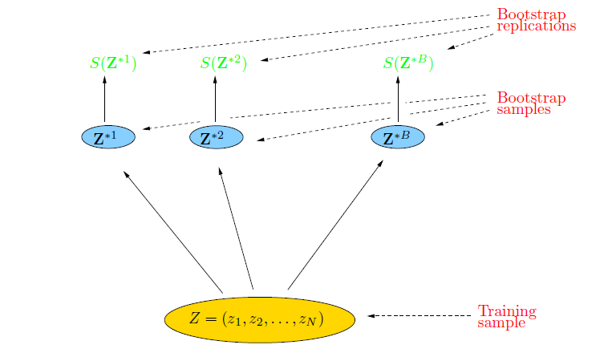
Bootstrap
The basic idea:
randomly draw datasets with replacement from the
training data, each sample the same size as the original training set

Slide 23
Bagging
Create bootstrap samples
from the training data
M features
N examples
....…

Slide 24
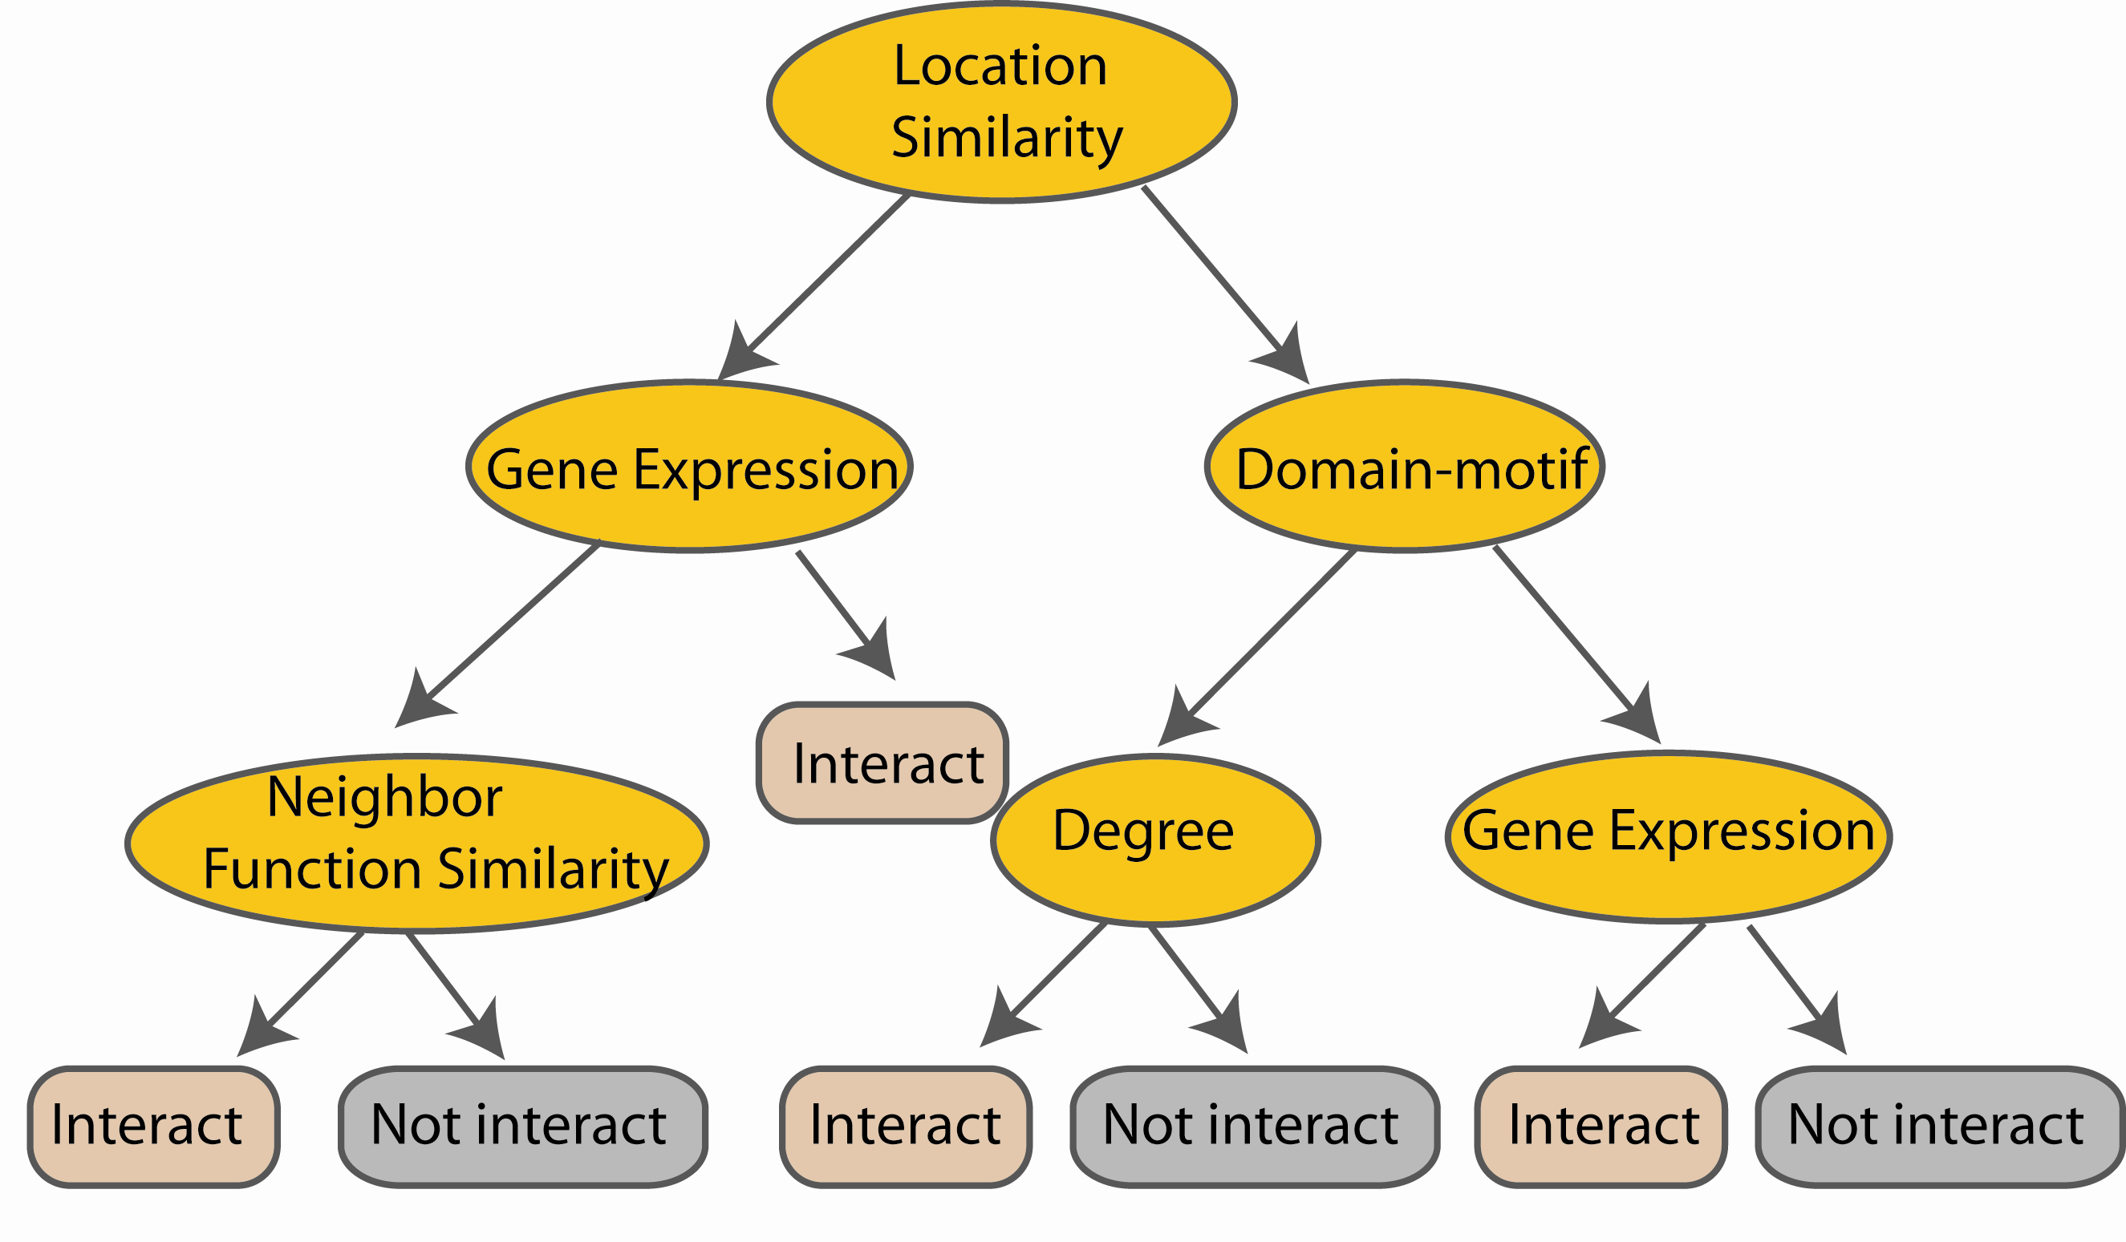
Random Forest Classifier
Construct a decision tree
M features
N examples
....…

Slide 25

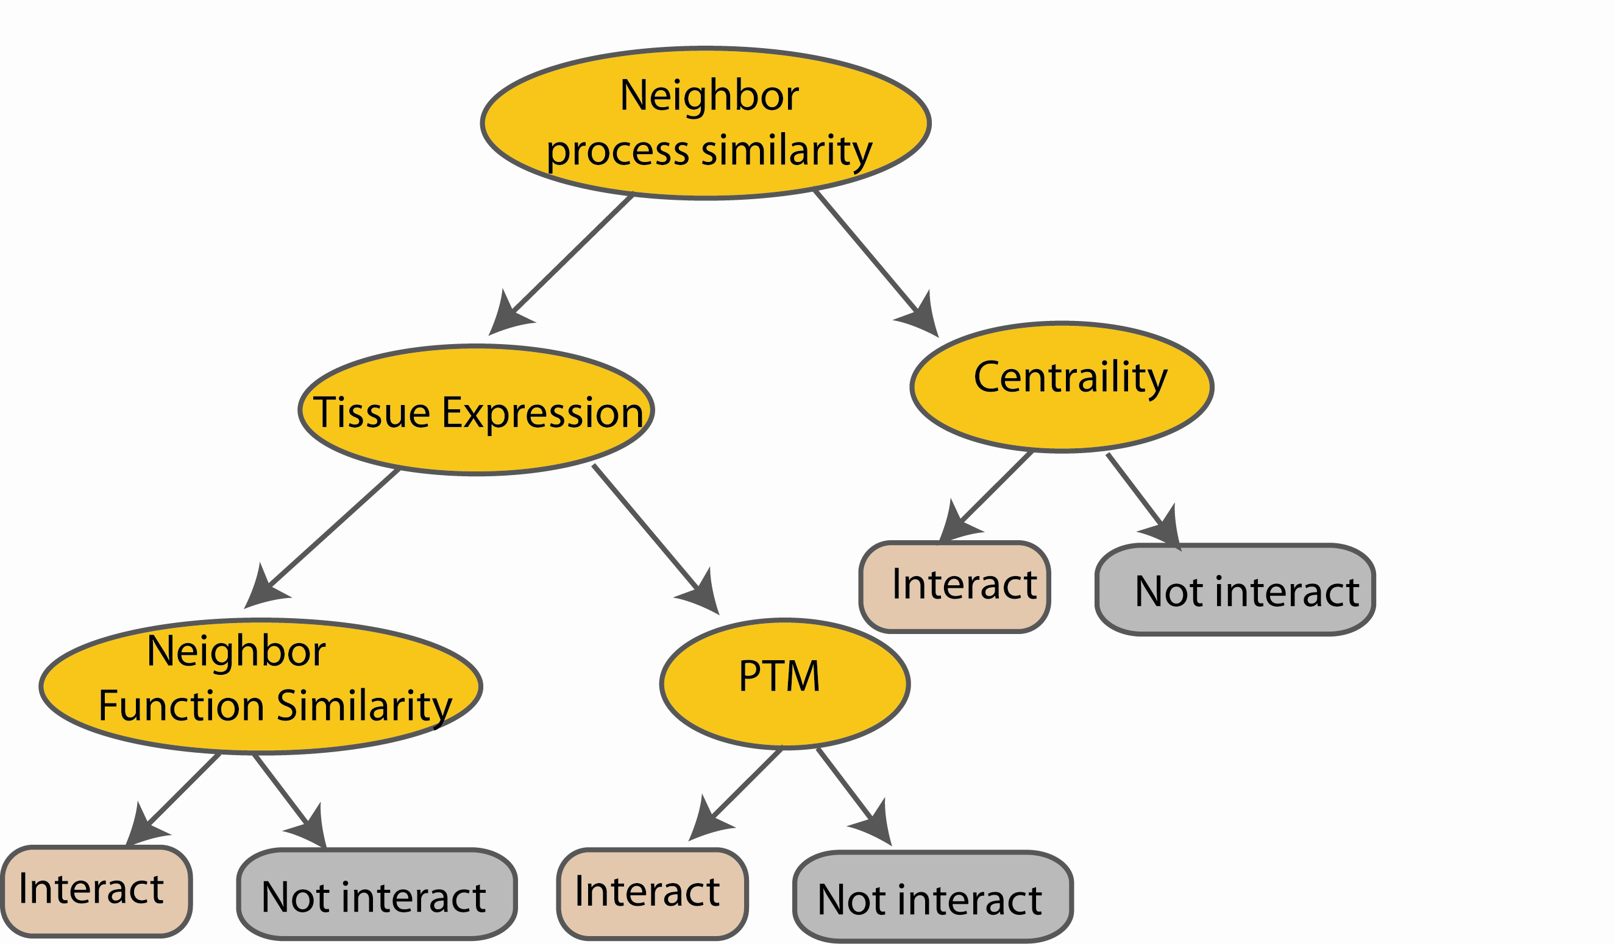
Random Forest Classifier
M features
N examples
Take the majority vote
....…
....…
Notes:
Finally the given an input data the decision is made as follows given an input data,

Slide 26
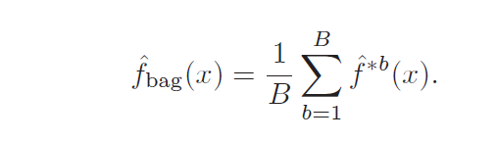
Bagging
Z = {(x₁, y₁), (x₂, y₂), . . . , (x_{N}, y_{N})} with B bootstrap samples Z^{*b} where b = 1,.., B.
The prediction at input x
when bootstrap sample
b is used for training
http://www-stat.stanford.edu/~hastie/Papers/ESLII.pdf (Chapter 8.7)

Slide 27
Bagging : an simulated example
Generated a sample of size N = 30, with two
classes and p = 5 features, each having a
standard Gaussian distribution with pairwise
Correlation 0.95.
The response Y was generated according to
Pr(Y = 1|x1 ≤ 0.5) = 0.2,
Pr(Y = 0|x1 > 0.5) = 0.8.

Slide 28
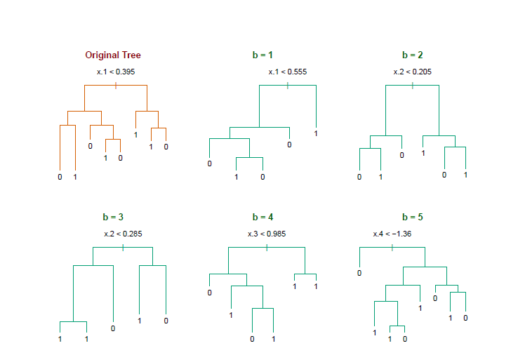
Bagging
Notice the bootstrap trees are different than the original tree

Slide 29
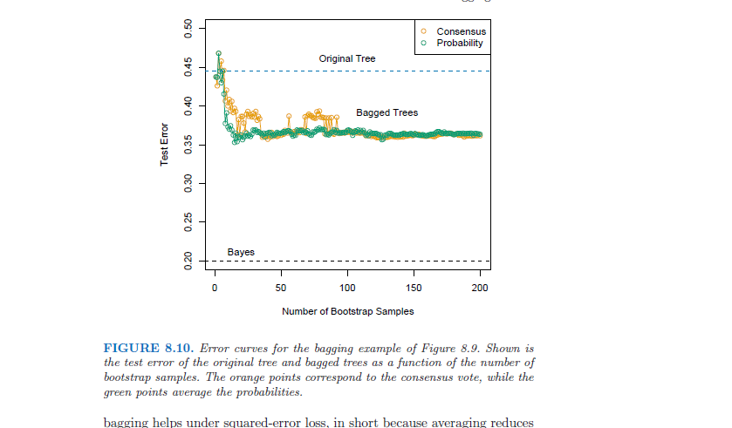
Bagging
Treat the voting
Proportions as
probabilities
Hastie
http://www-stat.stanford.edu/~hastie/Papers/ESLII.pdf Example 8.7.1

Slide 30
Random Forest classifier
Forest = many decision trees
Bagging
Use different subsets of features for each tree, to ensure they are different

Slide 31
Random Forest Classifier
Training Data
M features
N examples
Notes:
As the classifier of choice we adopt Random Forest Classifier, due to its robustness to heterogenous and noisy feature.
Random Forest is an ensembe classifier. Briefly, given N data and M features, bootsrap samples are created from the traning data

Slide 32
Random Forest Classifier
Create bootstrap samples
from the training data
M features
N examples
....…

Slide 33
Random Forest Classifier
Construct a decision tree
M features
N examples
....…
Notes:
From eachd descision tree .. In spliting the nodes, the Gini Gain is employed

Slide 34
Random Forest Classifier
At each node in choosing the split feature
choose only among m<M features
M features
N examples
....…
Notes:
Different from the regular decision trees in random forest, when the splitting feature is chosen from only a subset of allf eatures.
The robostness of the classifier arises from
bootsraping of the training data and the random selection of features, the the random choose of features.

Slide 35
Random Forest Classifier
Create decision tree
from each bootstrap sample
M features
N examples
....…
....…

Slide 36
Random Forest Classifier
M features
N examples
Take he majority vote
....…
....…
Notes:
Finally the given an input data the decision is made as follows given an input data,

Slide 37
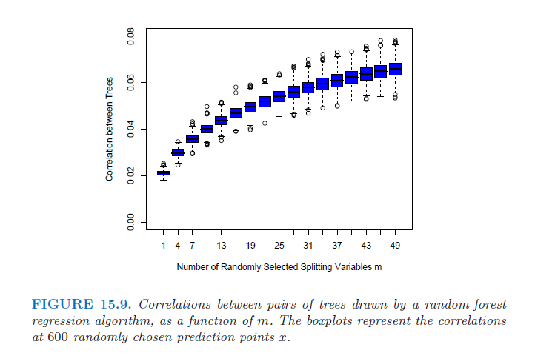

Slide 38
Random forest
Available package:
http://www.stat.berkeley.edu/~breiman/RandomForests/cc_home.htm
To read more:
http://www-stat.stanford.edu/~hastie/Papers/ESLII.pdf

